Slide 1
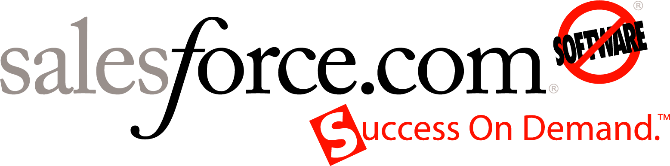

Platform as a Service
Changing the Economics of Innovation
Jim Rivera
VP Product Management

Slide 2
Safe Harbor
Safe harbor statement under the Private Securities Litigation Reform Act of 1995: This presentation may contain forward-looking statements that involve risks, uncertainties, and assumptions. If any such uncertainties materialize or if any of the assumptions proves incorrect, the results of salesforce.com, inc. could differ materially from the results expressed or implied by the forward-looking statements we make. All statements other than statements of historical fact could be deemed forward-looking, including any projections of subscriber growth, earnings, revenues, or other financial items and any statements regarding strategies or plans of management for future operations, statements of belief, any statements concerning new, planned, or upgraded services or technology developments and customer contracts or use of our services.
The risks and uncertainties referred to above include – but are not limited to – risks associated with developing and delivering new functionality for our service, our new business model, our past operating losses, possible fluctuations in our operating results and rate of growth, interruptions or delays in our Web hosting, breach of our security measures, the immature market in which we operate, our relatively limited operating history, our ability to expand, retain, and motivate our employees and manage our growth, new releases of our service and successful customer deployment, our limited history reselling non-salesforce.com products, and utilization and selling to larger enterprise customers. Further information on potential factors that could affect the financial results of salesforce.com, inc. is included in our annual report on Form 10-K filed on April 30, 2008 and in other filings with the Securities and Exchange Commission. These documents are available on the SEC Filings section of the Investor Information section of our Web site.
Any unreleased services or features referenced in this or other press releases or public statements are not currently available and may not be delivered on time or at all. Customers who purchase our services should make the purchase decisions based upon features that are currently available. Salesforce.com, inc. assumes no obligation and does not intend to update these forward-looking statements.

Slide 3



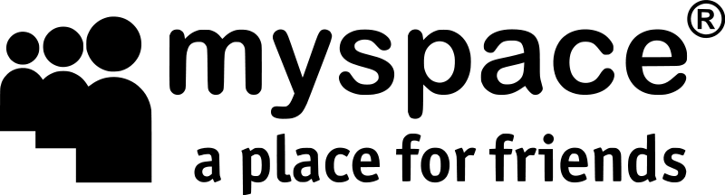










Cloud Computing Platforms as a Service
web 1.0
web 2.0
web 3.0
Killer Internet Apps
User Generated Content
Platforms
S3 & EC2
Everyone Can Access
Everyone Can Publish
Everyone Can Innovate
Notes:
1.0
Improve accessibility of information and services
Early examples of SaaS
Driving costs down – delivery model eliminates the considerable burden of hosting and maintaining apps.
- reduced deployment times
- instant provisioning
2.0
User generated content
Collaboration
- leverage the wisdom of the crowds
3.0
Removing the traditional barriers to innovation.
Enabling the development, deployment of web 1 and 2.0 apps without the incredible burden of building and managing your own databcener
Seeing numerous examples, becoming one of the hottest topics today
Concept of a platform can be very confusing, different definitions depending on who you talk to

Slide 4


Types of Platform as a Service Offerings
Level 4
Application
Services
Leverage shared application services, multi-tenancy
Level 3
Virtualization
Code runs in the cloud
S3 & EC2
Level 2
Plug-in API
External code injects functionality
Level 1
Web Services
API
External code calls API
Notes:
Framework borrowed from blog post from Marc Andreesen, and extended
Definition – platform is a system that can be programmed to serve countless needs that the original platform developers most likely never intended
From simplest to the most complex and feature rich. Each level tends to be a superset of the preceding levels
Level 1 – google maps, search are other examples, Useful but still pretty limited
Level 2 – eclipse, firefox, etc. Expertise and financial resource requirement are very high, limits the potential market for level 2 developers
Level 3 and 4 - the level of technical expertise required of someone to develop on your platform drops by at least 90%, and the level of money they need drops to $0. opens up to a whole new universe of developers
Level 3 – focused on providing very general computing infrastructure services. Amazon – linux, google - python
Level 4 – focused on providing higher-level application services, typically focused on a particular type of application

Slide 5
Why Multi-Tenant? Increased Efficiency
Single Tenant Efficiency
Utilized
20%
Utilized
35%
Business
30%
Wasted
80%
Wasted
65%
Upkeep
70%
Server Capacity
Storage Capacity
Labor
Source: Nick Carr, “The Big Switch”
Notes:
From nick carr’s book about how computing is turning into the next big utility as we’ve seen in the past with electricity and water.
Capacity planning get much easier when you are dealing with a very large number of users with heavy load, because the traffic load becomes much more predictable. And it becomes much easier to achieve significantly higher levels of utilization which systems which can easily scale horizontally to take on additional load.
As for labor, we benefit from huge economies of scales because the overhead associated individual instance is shared with across a great number of customers. Costs from:
Maintenance
Achieving high availability
Functionality upgrades

Slide 6

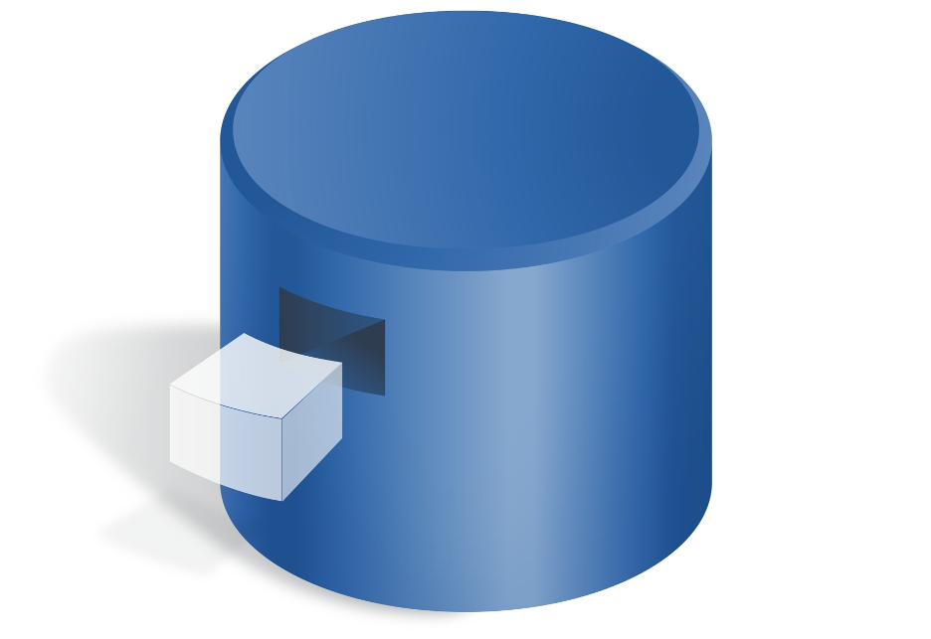


Multi-Tenancy Delivers Performance at Scale
Serves Companies of All Sizes
1
1
Your Company
2
Your Division
Query Optimization Engine
Your Data
3
Your Customizations
4
Your Sharing Model
Immediate Response
Massive Scale
Sub-second response time
Billions of transactions
Notes:
Democratizing enterprise scalability and performance for companies or divisions at any size scale or capability.
We have can spend incredible resources tuning are databases to be completely optimized… some of the best DB engineers in the industry
All companies can take advantage of the same set of capabilities regardless of their size
At the same time, architecture ensure that users only have access to their own data
And optimizes queries to achieve sub-second response time whether you are in a 5 person org, or 50K person org with millions rows of data and complex sharing models.
So whether you are a very large company or a small shop, you get the benefits of very sophisticated, enterprise-level services

Slide 7
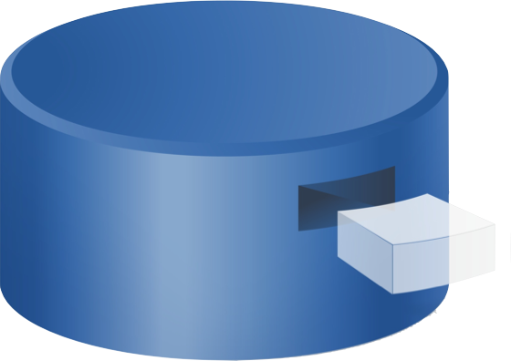

Platform as a Service Requires a New Architecture
Customize and Build Without Upgrades
UI & API
Customize or build any app
Apps stored in database as metadata
Platform infrastructure and upgrades separated from your apps
Customizations and apps run on the latest release automatically
each customer’s metadata
your clicks
Your Implementation
logic
your code
40,000+ customers
69,000+ custom apps
database
single code base and shared infrastructure
25+ Major Upgrades
Notes:
One of the benefits of PaaS is that all infrastructure, and the challenges associated with managing that infrastructure, is abstracted as a set of services with consistent interfaces and consistent behavior.
Which means code you write keeps working even when the underlying infrastructure is upgraded.
It is necessary to decouple core infrastructure and services from application instances
Cannot break users code or integrations, even during upgrades
Enables rapid product release cycles, accelerating the delivery of new capabilities to market.

Slide 8







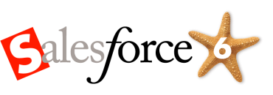
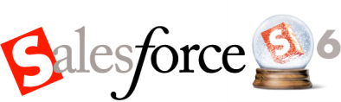
Platform as a Service Enables Reactive Innovation
26 Major Releases in 9 Years
All Customizations Upgraded Automatically

Slide 9
Changing the Economics of Innovation
You
Hardware Infrastructure
Software Infrastructure
Technical
Operations
Business
Operations
Your
App
Network
Storage
Operating System
Database
App Server
Web Server
Data Center
Disaster Recovery
Security
Sharing
Integration
Customization
Web Services
API
Multi-Language
Multi-Currency
Workflow
Analytics
Multi-Device
Messaging
Search
Monitoring
Patch Mgmt
Upgrades
Backup
NOC
Ordering
Provisioning
Licensing
Billing
Renewal
Upgrades
Marketing
Sales
Notes:
9

Slide 10
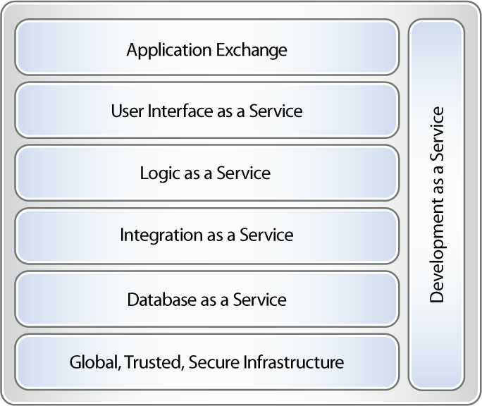
What Does a PaaS Look Like?

Slide 11
Demo

Slide 12
Q & A

Slide 13

Jim Rivera
VP Product Management
jrivera@salesforce.com

